Slide 1
Computer Architecture
Lectorial 1 – Introduction to the unit

Slide 2
Objectives
In this session we will:
Introduce ourselves
Explain the approach to the unit
Describe the weekly structure and how the Moodle area will be used
Give an initial outline of what the assessment will involve
Recommended reading and getting support
Weekly schedule
Start the week 1 concepts on logic gates

Slide 3
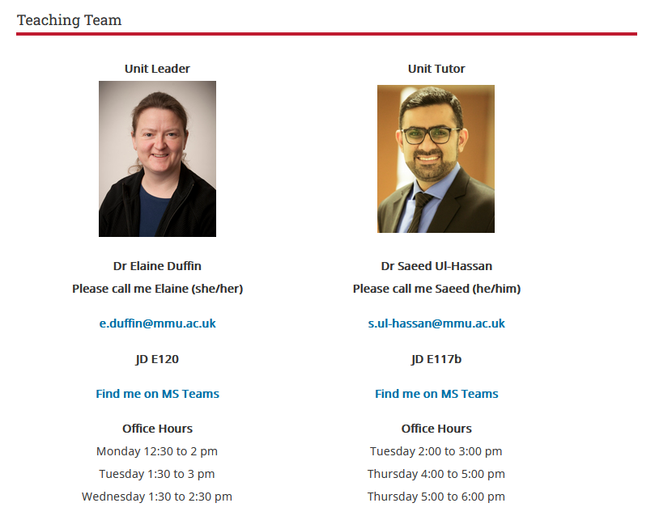
Unit Team
Moodle has
Clickable links to message us by email or MS Teams message

Slide 4
What will the unit cover?
The main aim is to understand enough about computers to be able to explain what happens when a program runs.
There will be some simplifications, but enough detail to give a starting point if you wanted to research further.
We try to develop understanding through discussions and practical investigations.
We will use software tools to emulate digital electronic circuits starting at logic gates and exploring circuits. Ultimately you will get the opportunity to emulate a very simple programmable computer.
An assembly language emulator will further develop ideas in the use of registers and system calls and understanding the how programs run.

Slide 5
Software required
Logisim
Educational tool for designing and simulating digital logic circuits
Download information:
http://www.cburch.com/logisim/download.html
MARS MIPS Assembly Language and Runtime Simulator
Educational tool for coding and running MIPS Assembly language programs
Can step through programs and see contents of registers
Available from:
https://courses.missouristate.edu/KenVollmar/mars/download.htm

Slide 6
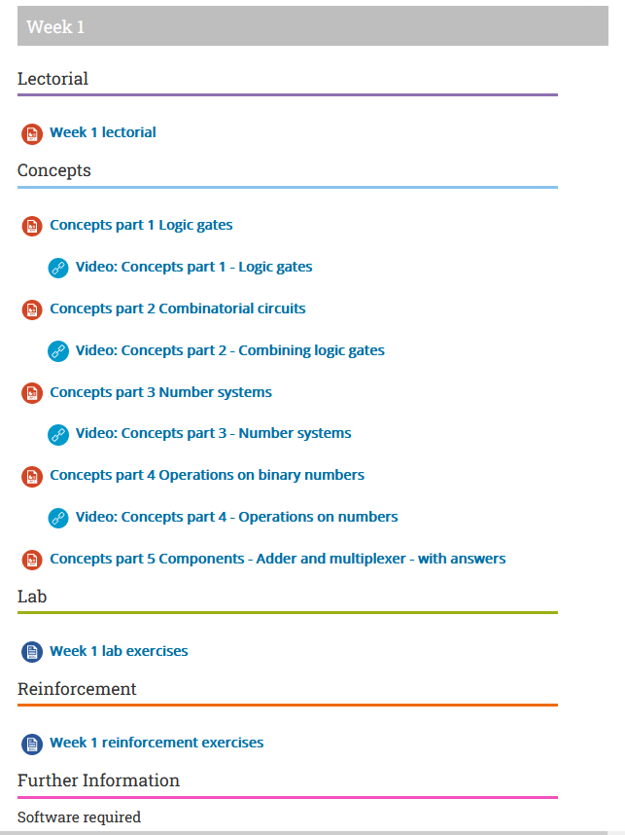
Weekly structure on Moodle
Lectorial
Concepts
Lab session
Reinforcement exercises
Further resources

Slide 7
Weekly structure – Lectorial
Cross between lecture and tutorial
Future weeks will cover the previous week’s reinforcement exercises
This will include walk-throughs and demos
You should have your work available to check
Making links to programming in Java
Looking forward to that week’s topics
Introduction to concepts that will be used in that week’s practical tasks
Lectorial sessions will be recorded and made available from Moodle

Slide 8
Weekly structure – Concepts and Labs
Concepts
Some of the new concepts will be introduced in the lectorials
The slides covering all the new concepts for the week will be available
Videos will be available – this is to support those who feel that the presentation in the lab might be too fast
Labs
Mainly structured into three 1-hour activities
The tutor will present a concept using the concepts materials or give a brief recap from the lectorial
The tutor may do a demo to start the practical work off
Students work individually or in small groups on the practical investigations
The tutor will show a solution or lead a discussion into the findings from the practical – build understanding through discussion and review

Slide 9
Weekly structure – Reinforcement and Further Information
Reinforcement
These are the exercises you are expected to do during your independent study time before the following lectorial session
These usually continue or enhance the investigations done in the labs
You should work in small groups where possible
Some of the tasks are deliberately challenging
Build understanding through practical investigation and discussion
If you have time, you should start them in the lab session
Further information
Several weeks will have suggestions for taking the ideas further
Some weeks will have links to other background materials

Slide 10
Assessment
Learning outcomes
Develop a sequential, digital electronic circuit using emulation software to a strict specification and document that development.
Build a structured assembly language program that uses both system calls and a range of memory locations in a microprocessor to invoke higher order sequential operation from a microprocessor and reflectively document that operation and contrast it to Learning outcome 1.
A report (approx 2,000 words) will demonstrate the use of circuit simulation software and an assembly language emulator to bridge the gap between the discreet use of electronic building blocks and microprocessor architecture. Invariably this will involve the implementation of low-level sequential logic at a logic gate level and the use of system calls and registers to achieve broadly similar effects.

Slide 11
Assessment
Three parts
Logisim practical work
MIPS Assembly language practical work
Written discussion
All parts to be included in a report

Slide 12
Employability
The assessment and the unit as a whole aim to encourage the following:
Careful, systematic work and testing of the work
Logical thinking and problem solving
Communication of your work and ideas
Using appropriate technical language

Slide 13
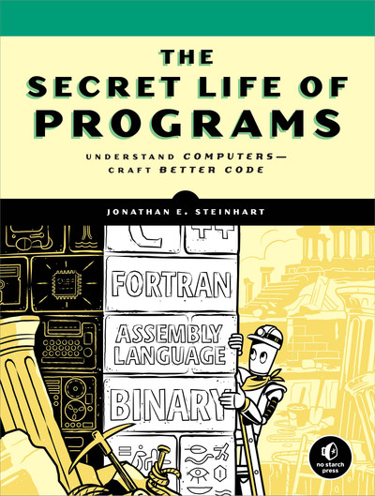
Recommended reading
The Secret Life of Programs Understand Computers – Craft Better Code by Jonathan Steinhart (2019)
“fills in the gaps in computer education by giving readers a look under the hood of programming, at the machine. Readers learn how software behaves when running on hardware; how programs manipulate data in memory; how computers process languages”
Notes:
https://web.stanford.edu/class/cs101/software-1.html
http://www2.hawaii.edu/~takebaya/ics111/process_of_programming/process_of_programming.html

Slide 14
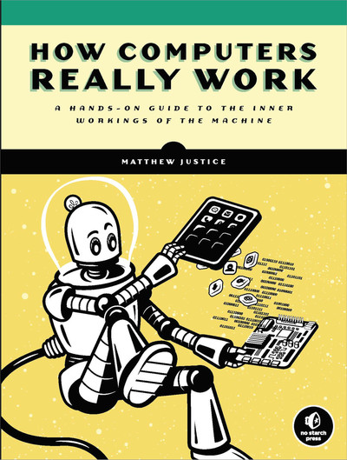
Other reading
Several other books are linked from Full Reading List on Moodle
Most of those books are available through O’Reilly Online Learning
For example
How Computers Really Work by Matthew Justice (2021)

Slide 15
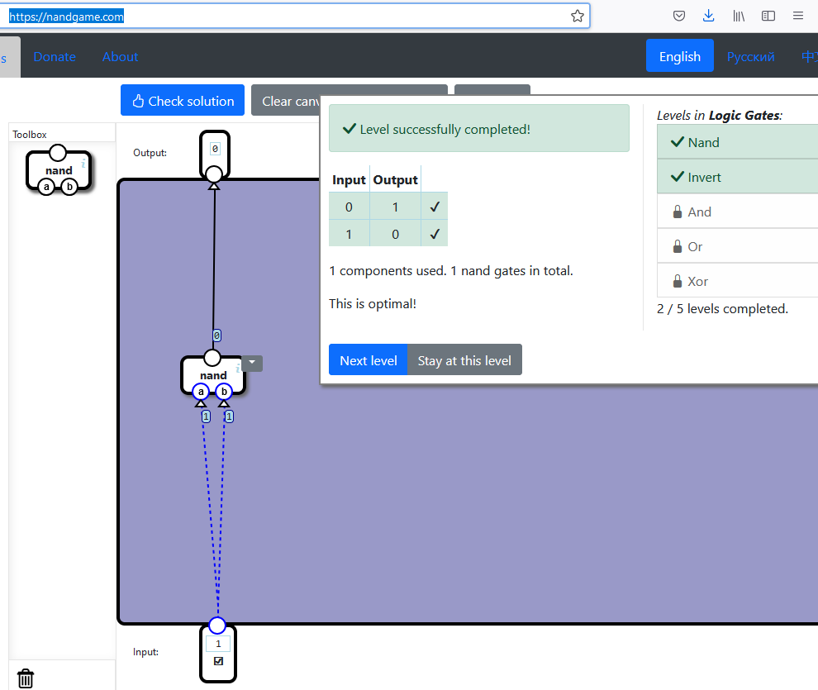
Recommended activity
Work through https://nandgame.com/
Build a computer starting from basic components.
In each level, you are tasked with building a component that behaves according to a specification. This component can then be used as a building block in the next level.
We will take a similar approach in Logisim

Slide 16
Expectations
Attend and engage with the timetabled sessions
If you have missed a session, use the Moodle resources to look at the concepts as the labs build ideas based on the previous concepts
Investigate and discuss the concepts
Work on the concepts outside the timetabled sessions
You have 4 hours a week on your timetable and should do about 8 hours a week in your own time
Continue any lab tasks that you need more time with
Try the reinforcement exercises and bring them to the next lectorial session
Start the coursework in plenty of time
Communicate with the teaching team and each other

Slide 17
Support
Contact us and make use of our office hours
Remember that you do not have to book to see us during office hours and can come to our offices, message us or have a video call via Teams
Discord server
There are some new channels for Computer Architecture on the Programming discord server
These are only visible to people taking this unit
See your Programming Moodle for information on how to join the Programming discord server, Lewis will need to confirm that you are taking the units
Support slots with Susan Lomax
See Moodle for bookable slots to go over a concept from this unit

Slide 18
Weekly schedule
Week 1 | Logic gates and circuits Number systems – binary and decimal
Week 2 | Data representation – text, images and negative numbers More complicated logic circuits - components
Week 3 | Circuits that have memory
Week 4 | Creating an automated device from components Little Man Computer
Week 5 | MIPS Assembly language programming
Week 6 | MIPS Assembly language programming

Slide 19
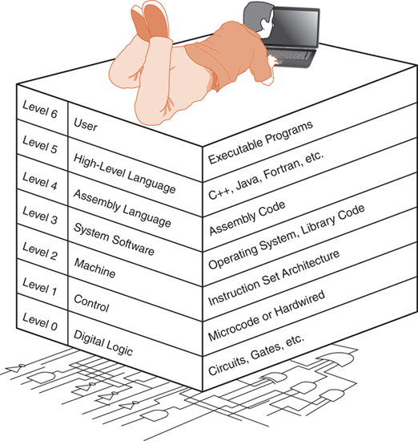
What happens when a program runs?
Computer systems can be thought of as having several levels
You have been programming in a high-level language (Java)
We will be looking at levels below that starting with digital logic
Image from The essentials of computer organization and architecture by Linda Null and Julia Lobur (2019)
Notes:
The essentials of computer organization and architecture

Slide 20




Binary data
Digital computers work on electronic components (transistors)
In computers an electrical signal is measured as being above or below a threshold, giving two possible states:
High / Low
On / Off
True (t) / False (f)
1 / 0
Anything that can be in two states is called binary
1
0
OR
1
0
OR

Slide 21
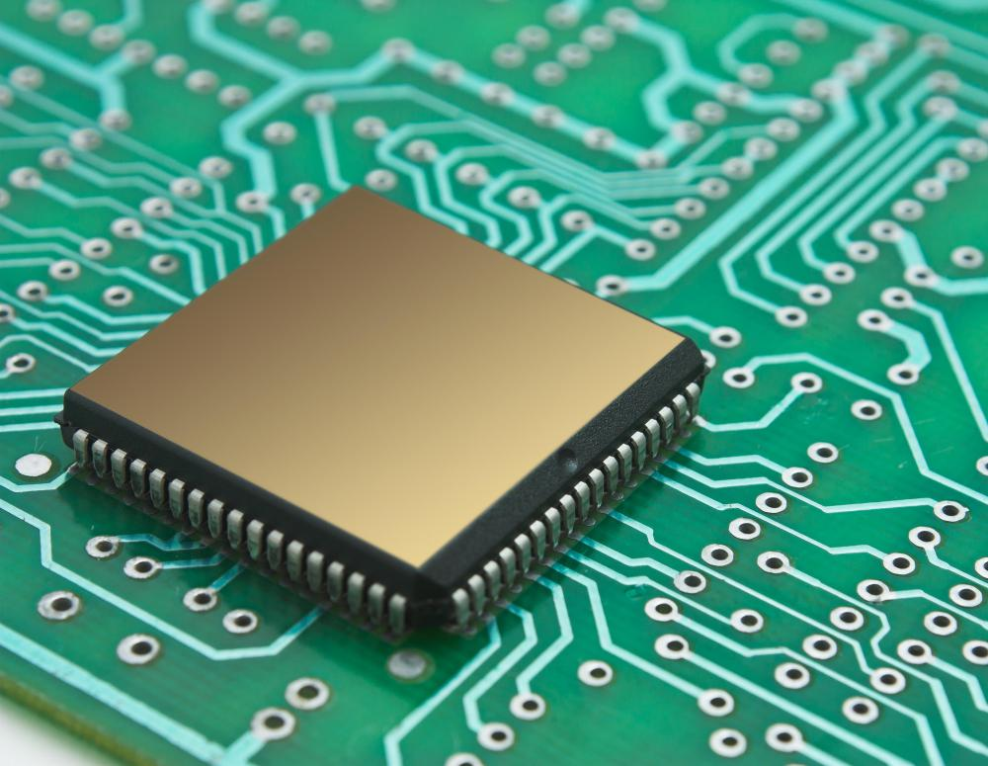
Logic gates
Logic gates form the basis of all processing in a digital computer
Many millions of logic gates are included in a computer chip
Logic gates use Boolean logic to take one or more inputs and produce a single output
Logic gates are deterministic
They always act in the same way when given the same input
Image credit: https://www.easytechjunkie.com/what-is-a-computer-chip.htm

Slide 22
AND Gate
A | B | X
0 | 0 | 0
0 | 1 | 0
1 | 0 | 0
1 | 1 | 1
Symbol
Truth table
Shows the output X for all possible inputs
The AND gate outputs 1 when all the inputs are 1
( X = 1 when both A AND B are 1 )
Boolean Notation : X = A . B
or
X = AB

Slide 23
OR Gate
A | B | X
0 | 0 | 0
0 | 1 | 1
1 | 0 | 1
1 | 1 | 1
The OR gate outputs a 1 when either OR both of the inputs is a 1
(X = 1 if A OR B = 1, OR both).
Boolean Notation : X = A + B

Slide 24

NOT Gate
A | X
0 | 1
1 | 0
The NOT gate outputs a 1 when the input is 0 and outputs a 0 when the input is 1.
The NOT gate is also referred to as an inverter, as it inverts its input
Boolean Notation : X = $\overline{A}$

Slide 25
Simple Circuits
We can use a truth table to work out the behaviour of a circuit with multiple inputs and outputs
Actual electronic components need a power supply
This standard symbolic notation doesn’t include the power supply
A | B | C | X | Y
0 | 0 | 0
0 | 0 | 1
0 | 1 | 0
0 | 1 | 1
1 | 0 | 0
1 | 0 | 1
1 | 1 | 0
1 | 1 | 1
0
1
0
1
0
1
0
1
0
0
0
1
1
0
1
1

Slide 26
Summary
You should have a general understanding of how the unit is structured
You should be familiar with the ideas of binary information, some logic gates and truth tables
In the lab session you will:
Recap the logic gates covered here and cover NOR, NAND and XOR
Look at the binary number system
Start to create components in Logisim that will be used to simulate a simple working computer

